Slide 1
Chapter 3 Overview
Overview of file system technology
Structure of executable files and malware
Goals and basic policies for file protection and sharing
File security controls based on “permission flags”

Slide 2
The File System
Modern computers keep files in a hierarchy of names – a hierarchy of “folders” or “directories”
Each file has a path name
Identifies the directory entries to follow to find the file
The file name selects the right file in the final directory in the path
Files are owned by a user, usually the creator
Access rights are tied to user identities
Example: Bob can read the file, but Alice can't

Slide 3
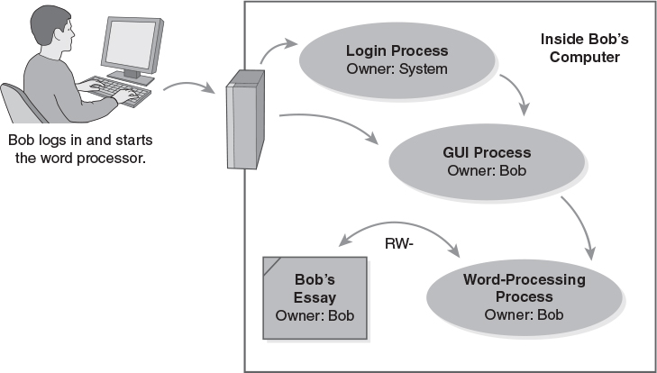
Process Ownership and Access

Slide 4
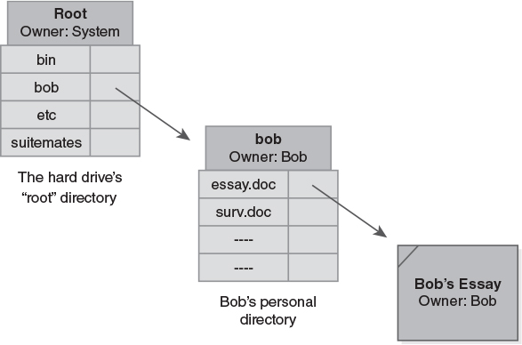
File and Directory Ownership

Slide 5
File and Directory Access Rights
“CRUD” – Create, Read, Update, Delete
Many systems let us control those rights
Different effects on files and directories
“Update” to directory = “delete” to its files
Protecting a newly created file: two strategies
Use “Defaults” – apply the same access rights to all new files
Use “Inheritance” – apply the access rights based on the enclosing directories

Slide 6
Common Directories
Windows
Home directories (C:\Users or C:\Documents and Settings)
Applications (C:\Program Files\)
System files (C:\Windows)
*nix
Home directories (/home)
Configuration files (/etc)
Log files (/var/log)
Applications (/usr)

Slide 7
Executable Files
Files that contain applications or other executable programs
“Binary executables” are stored in a control section and executed by the CPU
“Scripts” contain text interpreted by a programming language interpreter
Execute access right
Helps distinguish data files from programs
Must have the “Execute” right to execute a file containing a program

Slide 8
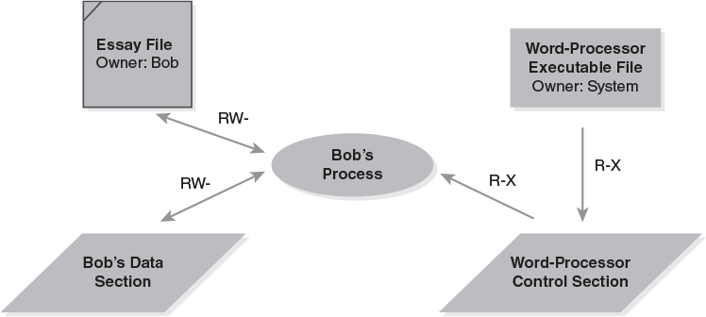
Execute Access Rights

Slide 9
Computer Viruses
A type of malware that enters computer systems.
Malware = malicious software
Viruses are carried by programs
When the program executes, the virus spreads to other programs on the computer
Propagation
Infected flash/disk drives
Drive-by downloads
Worms
Trojans (email/files)

Slide 10
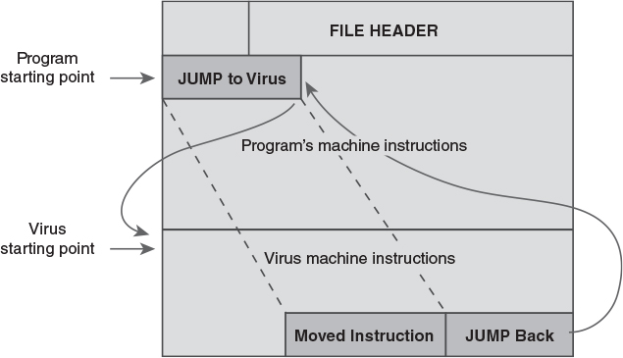
An Infected Application Program

Slide 11
A Modernized Infection
Attacker adds a “wrapper” to a legitimate app
When the legitimate app is chosen, the wrapper runs instead. It starts two separate processes:
First process is the malware
It runs invisibly in the background
May start other processes or apps
Second process is the legitimate app
Operates as usual
No obvious interference with its operation

Slide 12
Examples of Modern Malware
Waledac – spreads through email – creates a botnet that spreads spam and more malware
Conficker or Downadup – spread through Internet via Windows vulnerabilities – created a botnet used for spam and malware distribution
Pushdo/Cutwail – a botnet and spam package that used to produce 7 million messages a day
ZeuS – creates botnet focused on financial fraud
Stuxnet – attacks control logic in industrial plants; probable target was Iranian nuclear sites

Slide 13
Sharing and Protecting Files
Objectives for sharing files
Provide computing for authorized users
Preserve the chain of control
Permit/prevent general sharing among users
Risks – a generic set
Denial of service
Subversion
Masquerade
Disclosure
Forgery

Slide 14
Policy Alternatives
Global policies – applied to all users by default
Isolation policy – keep users separate
Sharing policy – let users share their files
Tailored policies
Modify rights for specific sets of files
Specific tailorings
Privacy – block some files from sharing
Shared reading – share some blocked files
Shared updating – full rights for some users
Notes:
p

Slide 15
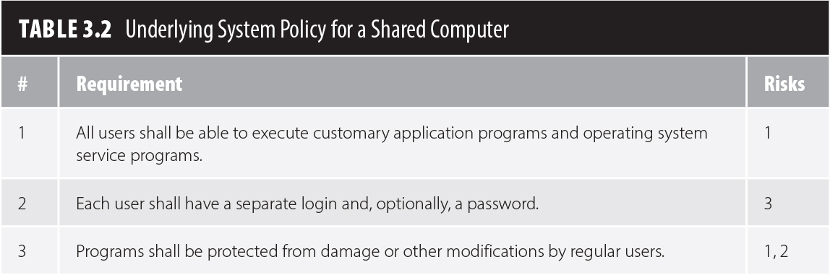
Underlying Policy on Shared System
Our policy must make it possible for users to share application programs
Three policy statements below allow this while defending against related risks.

Slide 16
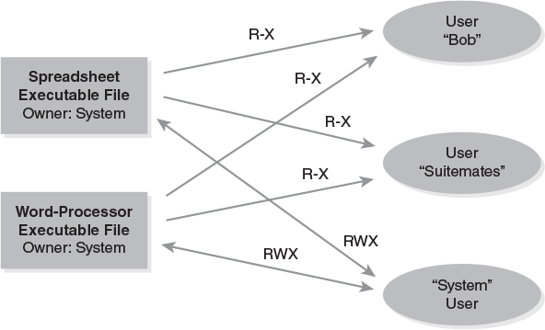
Executable Access Rights

Slide 17
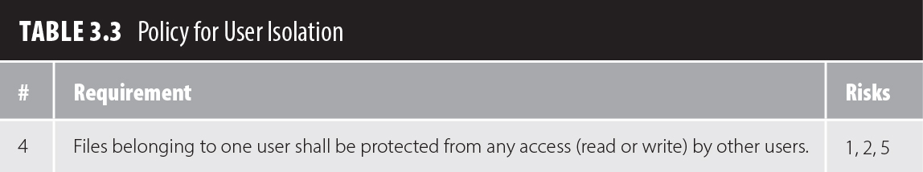
A Global Isolation Policy
By default, all personal files are kept private
Specific shared files are available
Addressed by the first three policy statements
Global policy requires one added rule:

Slide 18
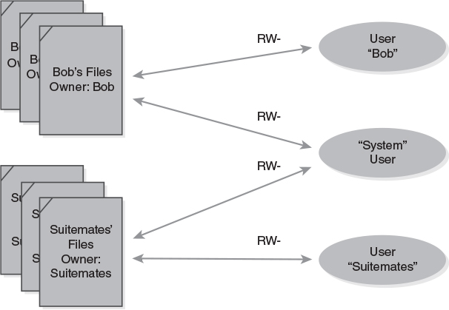
Isolation Policy

Slide 19
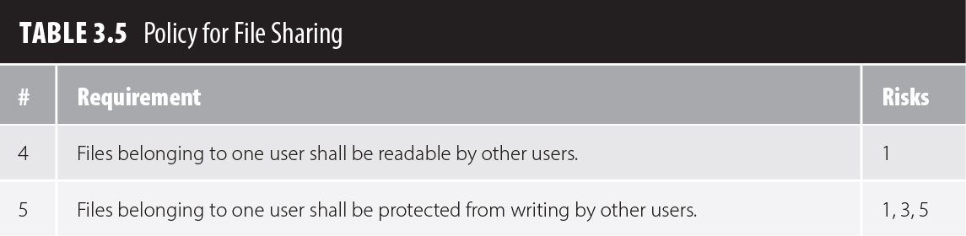
A Global Sharing Policy
By default, all personal files are shared
Readable by others but not writeable
Application files are also shared
Addressed by the first three policy statements
Global policy requires two statements
Replaces #4 in the global isolation policy

Slide 20
Security Controls
An operating system can protect files as long as:
The OS protections are always applied when we access our files, and
There is no way to bypass the OS protections
Basic principle: Deny by Default
We always start by granting no access
We add access rights
This makes it easier to assign the right permissions and achieve Least Privilege

Slide 21
States and State Diagrams
A technique to illustrate a system's behavior
Each state is a separate situation
Arrows between states show transitions
A transition indicates both cause and effect
An event causes the transition
An action may take place at the transition
A door may be Open or Closed – two states
The events Opening or Closing cause the transition between the states

Slide 22
Information States
Data or information may be in these basic states
Storage state
Stored in a computer, not being processed
“Data at rest”
Processing state
Being used by an active process
Usually stored in RAM
Transmission state
Being moved from one place to another
“Data in motion”

Slide 23
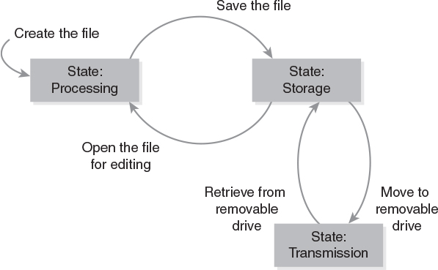
Example: Bob's Essay

Slide 24
The Security Patch Race
A race begins when a security problem arises
The software developer races to develop a fix to eliminate the problem
Attackers race to write software that exploits the problem and lets them attack computers
Attack software is an exploit
Unpublicized vulnerability is a ”zero day”
Any computer that doesn't patch the problem may be vulnerable to the exploit
Window of vulnerability = time during which an exploit exists but computers aren't patched

Slide 25
Patching Security Flaws
The patching process
Collect error reports
Prioritize errors and assign to engineers
Engineer develops software to fix the error
Software fixes are chosen for a patch
The patch is tested
The patch is released
This applies to all flaws including security flaws
Security fixes may have higher priority

Slide 26
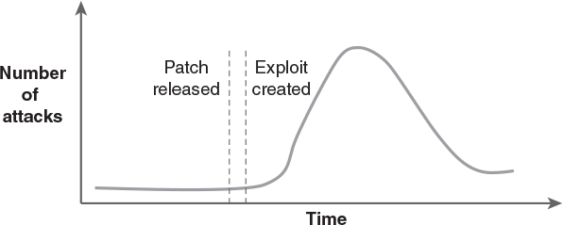
The Risk of Delayed Patching

Slide 27
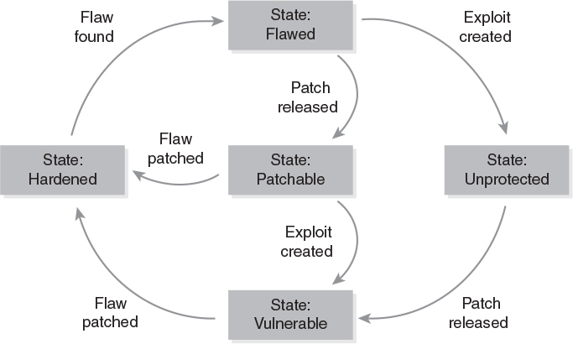
A State Model of Patching

